Slide 1
Syntax-Directed Translation
Notes:
``

Slide 2
Syntax-Directed Translation
The principle of syntax directed translation states that the meaning of an input sentence/string is related to its syntactic structure, i.e., to its Parse-Tree.
By syntax directed translations, we indicate those formalisms for specifying translations for programming language constructs guided by context-free grammars.
– We associate attributes to the grammar symbols representing
the language constructs.
– Values for attributes are computed by semantic rules associated
with grammar productions.
Notes:
``

Slide 3
Syntax-Directed Translation (Cont..)
There are two notations for attaching semantic rules with the productions:
1. Syntax Directed Definitions
High-level specification hiding many implementation details
(also called Attribute Grammars ).
2. Translation Schemes
More implementation oriented: Indicate the order in which
semantic rules are to be evaluated.
Notes:
`` `

Slide 4
Syntax-Directed Translation (Cont..)
In both approaches, we parse the input token stream, build the parse tree, and then traverse the tree to evaluate the semantic rules at the parse tree nodes.
Evaluation of semantic rules may:
  Generate intermediate codes
  Put information into the symbol table
  Perform type checking
  Issue error messages
Notes:
`` `

Slide 5
Syntax-Directed Definition
Syntax-directed definitions are a generalization of context-free grammars in which:
- Grammar symbols have an associated set of Attributes
- Productions are associated with semantic rules for computing the
values of attributes
Such formalism generates annotated parse trees where each node of the tree is a record with a field for each attribute (e.g., X.a indicates the attribute a of the grammar symbol X ).
The value of an attribute of a grammar symbol at a given parse tree node is defined by a semantic rule associated with the production used at that node.

Slide 6
Syntax-Directed Definition (Cont..)
An attribute can represent anything: a string , a number, a type, a memory location, or etc.
We distinguish between two kinds of attributes:
1. Synthesized Attributes
- They are computed from the values of attributes of the children
nodes.
2. Inherited Attributes
- They are computed from the values of attributes of both the
siblings and the parent nodes.
A parse tree showing the values of attributes at each node is called an annotated parse tree.

Slide 7
Form of Syntax Directed Definitions
Each production, A → α is associated with a set of semantic rules:
b := f(c1, c2, . . . , ck), where f is a function and either
1. b is a synthesized attribute of A, and c1, c2, . . . , ck are attributes
of the grammar symbols in α of the production, or
2. b is an inherited attribute of a grammar symbol in α, and c1, c2, .
. . , ck are attributes of grammar symbols in α or attributes of A
Note: Terminal symbols are assumed to have synthesized attributes supplied by the lexical analyzer, but don’t have inherited attributes.
Procedure calls define values of dummy synthesized attributes of the nonterminal on the left-hand side of the production.

Slide 8
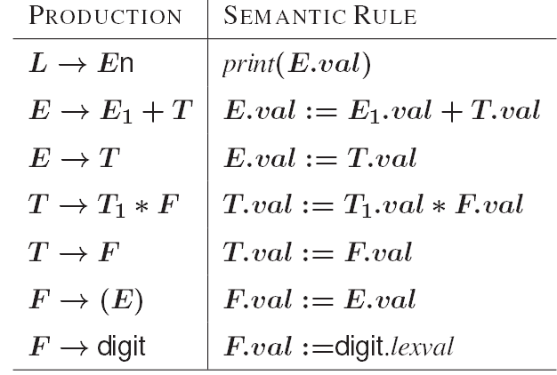
Syntax Directed Definitions: An Example
Let us consider the Grammar for arithmetic expressions. The syntax directed definition associates to each nonterminal a synthesized attribute called val.

Slide 9
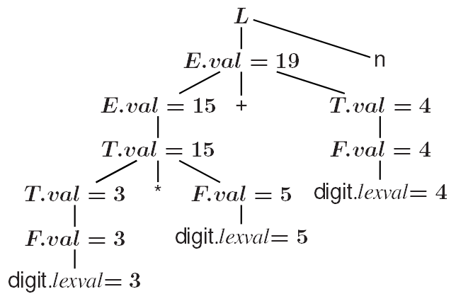
S-Attributed Definitions
An S-attributed definition is a syntax directed definition that uses only synthesized attributes.
• Evaluation Order: semantic rules in a S-attributed definition can be
evaluated by a bottom-up, or post-order traversal of the parse tree.
• Example: The previous arithmetic grammar is an example of an S-
attributed definition. The annotated parse-tree for the input 3*5+4n
is:

Slide 10
Inherited Attributes
Inherited attributes are useful for expressing the dependence of a programming language construct on the context in which it appears.
It is always possible to rewrite a syntax directed definition to use only synthesized attributes, but it is often more natural to use both synthesized and inherited attributes.
Evaluation Order: Inherited attributes cannot be evaluated by a simple pre-order traversal of the parse-tree:
– Unlike synthesized attributes, the order in which the inherited
attributes of the children are computed is important!!! Indeed:
(*) Inherited attributes of the children can depend from both
left and right siblings!

Slide 11
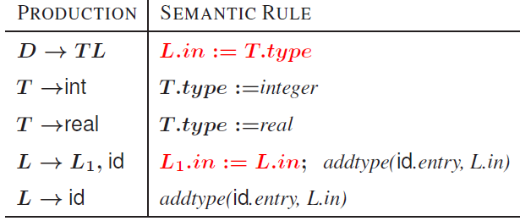
Inherited Attributes: An Example
Let us consider the syntax directed definition with both inherited and synthesized attributes for the grammar for “type declarations”:
The non terminal T has a synthesized attribute, type, determined by the keyword in the declaration.
The production D →TL is associated with the semantic rule L.in := T.type which set the inherited attribute L.in.
Note: The production L → L1, id distinguishes the two occurrences of L

Slide 12
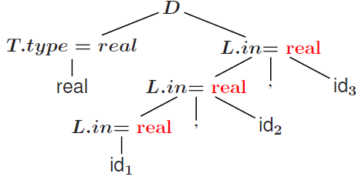
Inherited Attributes: An Example (Cont..)
Synthesized attributes can be evaluated by a post-order traversal.
Inherited attributes that do not depend from right children can be evaluated by a classical pre-order traversal.
The annotated parse-tree for the input real id1, id2, id3 is:
L.in is then inherited top-down the tree by the other L-nodes.
At each L-node the procedure addtype inserts into the symbol table the type of the identifier.

Slide 13
Dependency Graphs
Implementing a Syntax Directed Definition consists primarily in finding an order for the evaluation of attributes
– Each attribute value must be available when a computation is
performed.
Dependency Graphs are the most general technique used to evaluate syntax directed definitions with both synthesized and inherited attributes.
A Dependency Graph shows the interdependencies among the attributes of the various nodes of a parse-tree.
– There is a node for each attribute;
– If attribute b depends on an attribute c there is a link from the node
for c to the node for b (b ← c).
Dependency Rule: If an attribute b depends from an attribute c, then we need to fire the semantic rule for c first and then the semantic rule for b.
Notes:
`

Slide 14
Dependency Graphs (Cont..)
Put each semantic rule into the form b := f(c₁,c₂,…,c_{k})
Algorithm for dependency graph construction:
for each node n in the parse tree do
for each attribute a of the grammar symbol at n do
construct a node in the dependency graph for a;
for each node n in the parse tree do
for each semantic rule b := f(c1, c2, … ,ck ) associated with the
production used at n do
for i:=1 to k do
construct an edge from the node for ci to the node for b;

Slide 15
Example of Dependency Graph
Suppose A.a := f(X.x, Y.y) is a semantic rule for the production A → XY. This rule defines a synthesized attribute A.a that depends on the attributes X.x and Y.y.
Suppose X.i := g(A.a, Y.y) is a semantic rule for the production A → XY. This rule defines a synthesized attribute X.i that depends on the attributes A.a and Y.y.
A.a
X.x
Y.y
X.i
A.a
Y.y

Slide 16
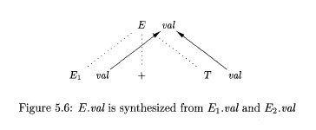
Example of Dependency Graph (Cont..)
Production Semantic Actions
E → E₁ + T E.val = E₁.val + T.val

Slide 17
Example of Dependency Graph (Cont..)
real id1, id2, id3
_{D}
D
_{L.in = real}
_{T.type=real}
4
type
in 5
L
6
T
_{L.in = real}
,
id₃
3
entry
_{real}
,
id₃
real
L
in 7
8
_{L.in = real}
,
id₂
,
2
entry
id₂
in 9
L
id₁
10
id₁
1
entry
Parse Tree
Dependency Graph

Slide 18
Evaluation Order of Semantic Rules
The evaluation order of semantic rules depends from a Topological Sort derived from the dependency graph.
Topological Sort: Any ordering m₁,m₂, . . . ,m_{k} such that if m_{i} → m_{j} is a link in the dependency graph then m_{i} appears before m_{j} in the ordering.
Any topological sort of a dependency graph gives a valid order to evaluate the semantic rules.

